Slide 1
LECTURE # 01 Introduction to BUILDING FORM AND FUNCTION

Slide 2
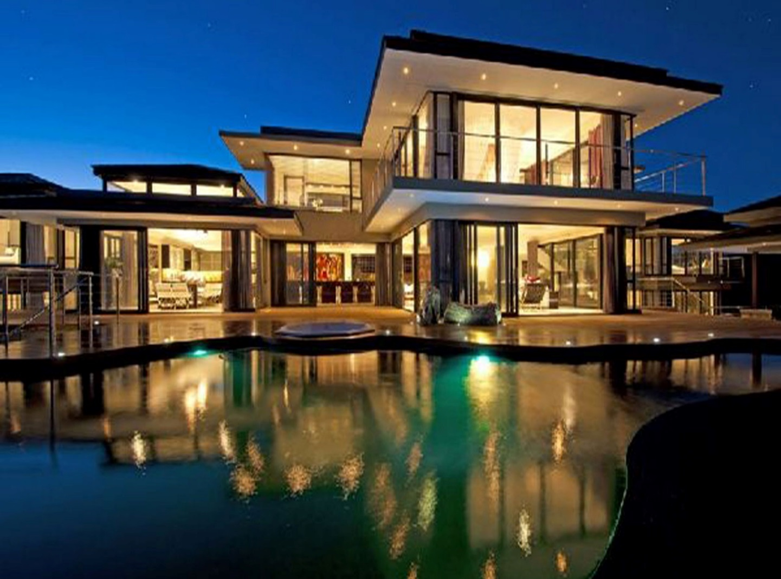
WHAT IS ARCHITECTURAL DESIGN?
Architectural Design is a concept that focuses on components or elements of a structure and unifies them to create a coherent and functional structure.
Architecture can also be defined as the adaptation of form to resist force.
(John Ruskin)

Slide 3
FORM
Form is the way the object, process or idea was designed so that it would work.
“The function of art is to endow raw and undisciplined materials with meaning—to transcend materials by giving them form.”
–Roger Sessions

Slide 4
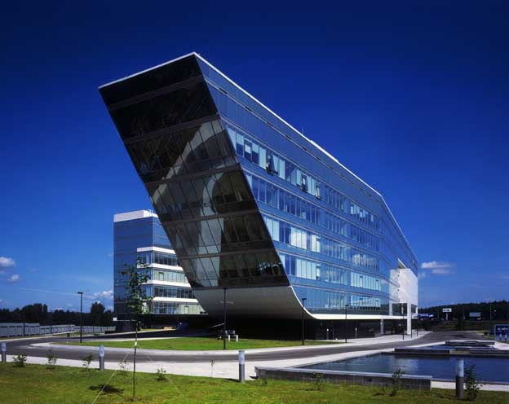

Slide 5
Concept of Form
Form refers to the shape or configuration of a building. It is the designer’s use of form that not only gives shape and structure to the raw materials of the world, it also provides a means to interpret those materials.
In a broader sense, form, in art, means the whole of a piece's visible elements and the way those elements are united. In this context, form allows us as viewers to mentally capture the work, understand it and attempt to analyze it.
A number of aspects must be considered in order to analyze or design an architectural form, including shape, mass / size, scale, proportion, rhythm, articulation, texture, color, and light.

Slide 6
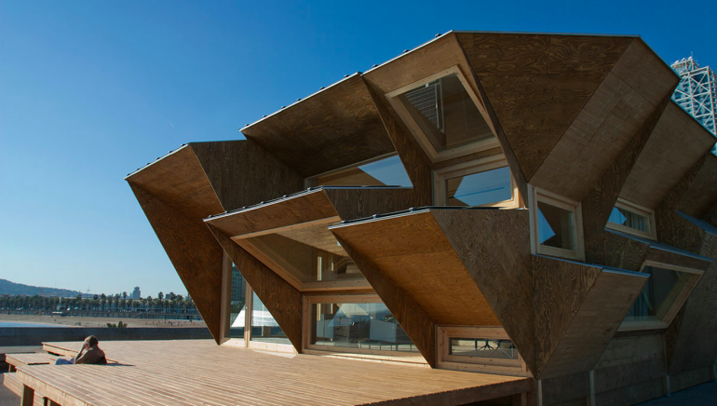
Concept of Form

Slide 7
Design Principles of Building Form
Consider neighboring properties when designing new developments. Pay attention to their position, height, mass and proportions.
Emphasis should be placed on local traditions to suit today’s needs.
Base the plan form of domestic buildings, including multiple occupancy buildings on rectangular forms.
Single storey structures are a simple and traditional way of providing additional ground ﬂoor area.

Slide 8
Design Principles of Building Form
House plans should generally avoid the use of unnecessary projections on the façade.
It is important that building form, architectural style, detailing and materials contribute to the character of an area.
Simple traditional forms are most effective in making sure that buildings fit in with their neighbors and create a balanced streetscape.
Simple building forms should be striking enough draw inspiration from local building traditions

Slide 9
FUNCTION
Function is the essential act that an object, process or idea should carry out.
It is the principle that architects should design a building based on the purpose of that building.
For example, when designing a home for a family, it makes sense to create open spaces for gathering and to provide ample storage. These choices encourage family interaction.

Slide 10
CONTI…
A house is meant as a space to live in, protecting us from the environment.

Slide 11
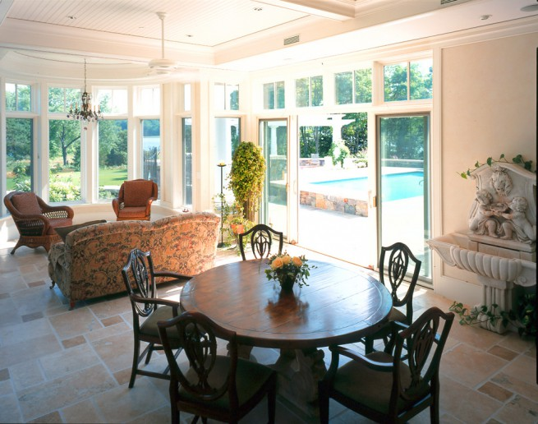
Examples of Function in House Design
House plans In architectural design small things/tasks matter a lot, even placement of chair is a task as it affects the functionality. It refers to develop better functional environment.
Living room and dining room have almost same size but the parameter is different as their use is different.
Vanity basin in washrooms is small (30”) while in kitchen it is (34”-36”) Because in washroom we go for a while, spend less time, bend to wash to avoid splashes of water in basin; in kitchen one has to do a lot of chores, stand a lot so an easy and comfortable height is given.

Slide 12
“FORM FOLLOWS FUNCTION”
“Form follows function” is based on “Form ever follows function,” a quote from Louis Sullivan’s Autobiography of an Idea.
The basic rule for any design is “Form follows function.” Thus the shape of a building or object should be primarily based upon its intended function or purpose.
“Form follows function” allows us to create designs where we can conceive of something that is completely impossible and somehow figure out how to make it functional.
Great architecture has this capacity to adapt to changing functional uses.

Slide 13
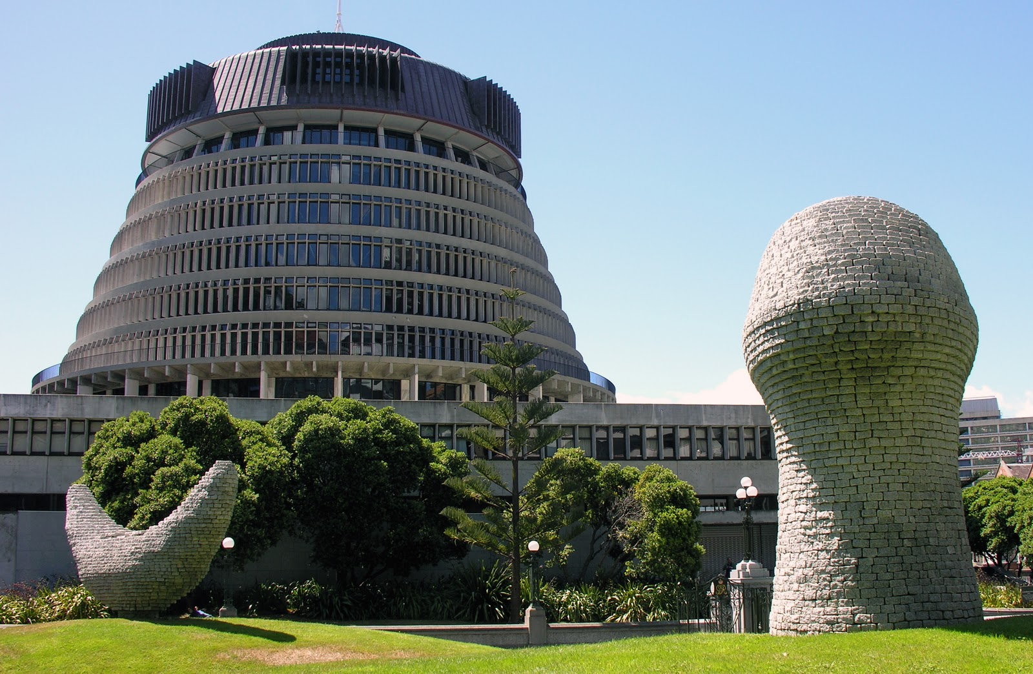
Witchcraft Building, Poland
Cabinet Building, New Zealand

Slide 20
CONCLUSION
Form follows function – that has been misunderstood. Form and function should be one, joined in a spiritual union.
- Frank Loyald Wright

